Slide 1
Course “Design Thinking & Making” KU Leuven, 2018
7 ideas for a better library
by Tobias Busch

Slide 2
7 times
7 ideas
“Fix” the e-books: Virtual Bookshelf
Air Quality Awareness: Canary Shared Metabolism
Peer Pressure: Peer-Pressure Helmet Seat Fighter
Information Sharing: CC Table Whispered Words of Wisdom
Problem statement
Idea (solution?)
Inspiration / moodboard
Comments from my inner critic

Slide 3
Virtual Bookshelf
1
Problem
Most new book releases are ebooks, but browsing through ebooks is tedious and boring.
How can we make browsing ebooks tangible and fun?
Using VR to bring the good parts of “browsing the stacks” to ebooks.
Different books should look different, popular books used, short books short, old books old.
Foster discovery and serendipity.
Check out books to read them on an e-reader.

Slide 4
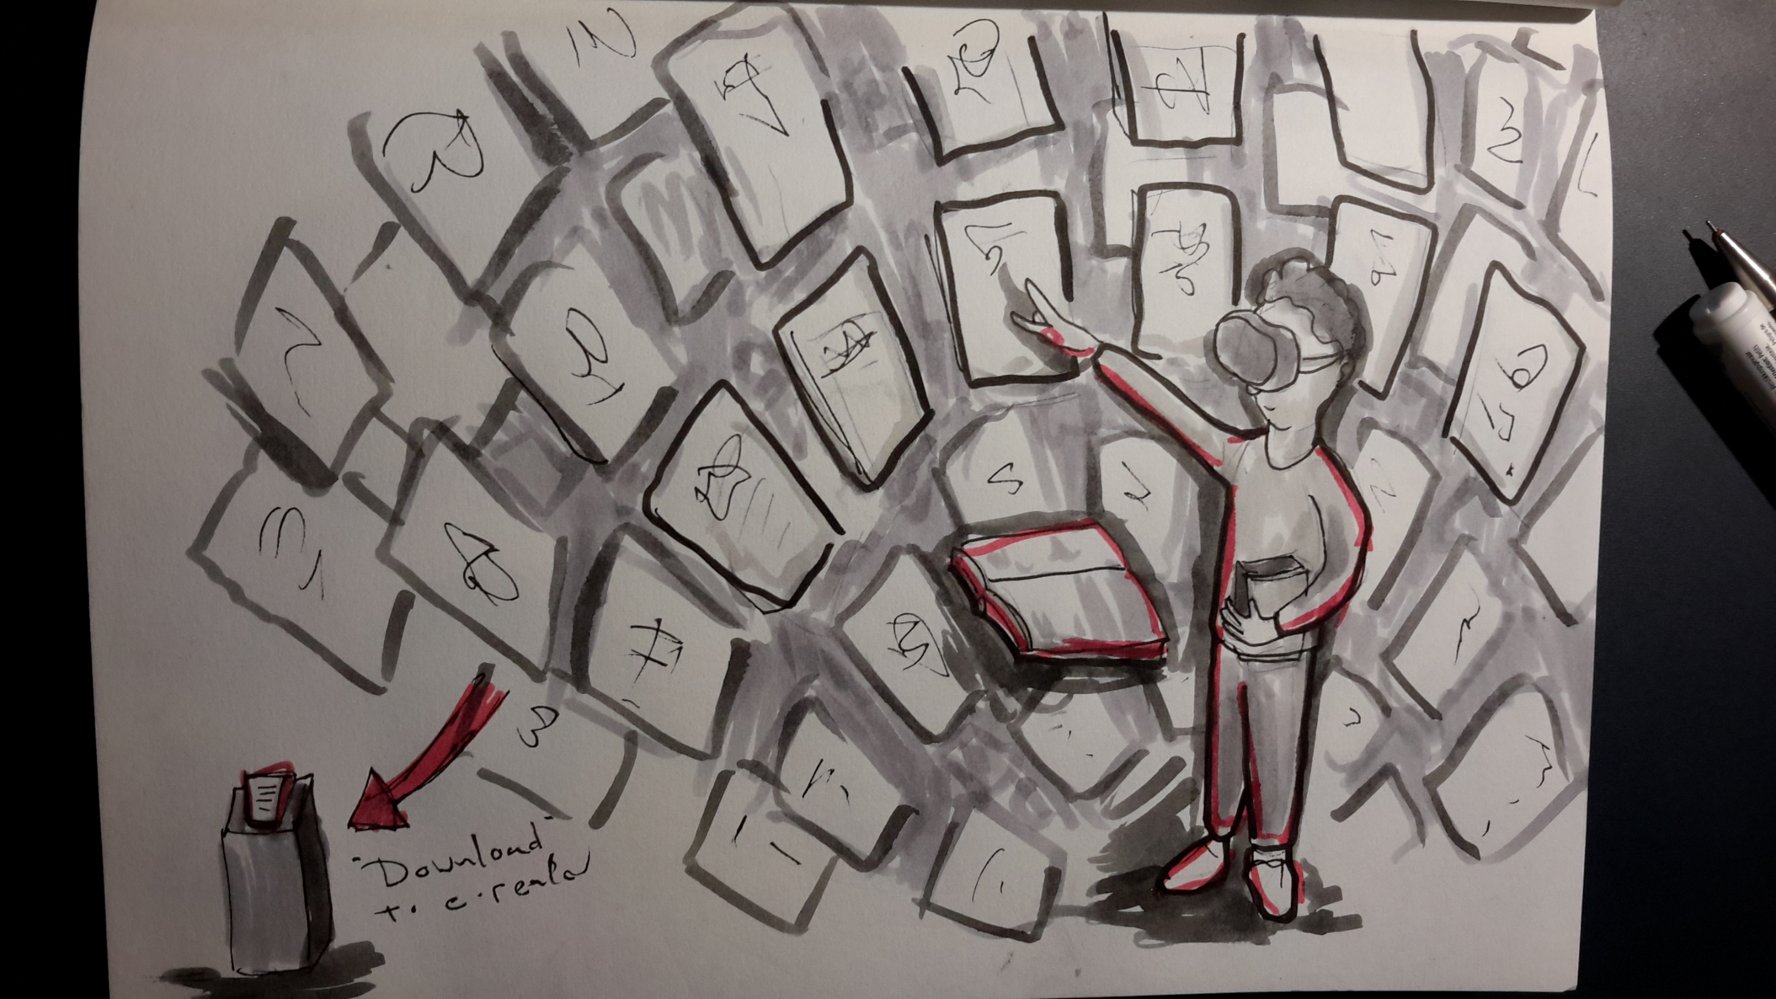

Slide 5
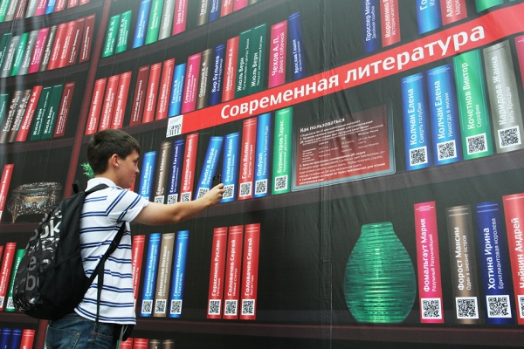
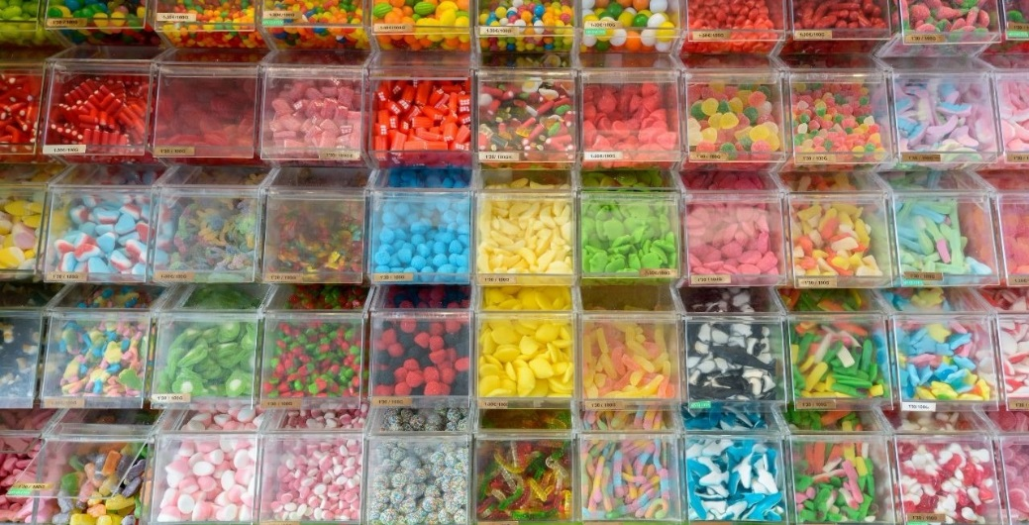
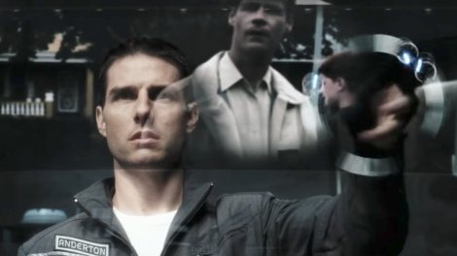
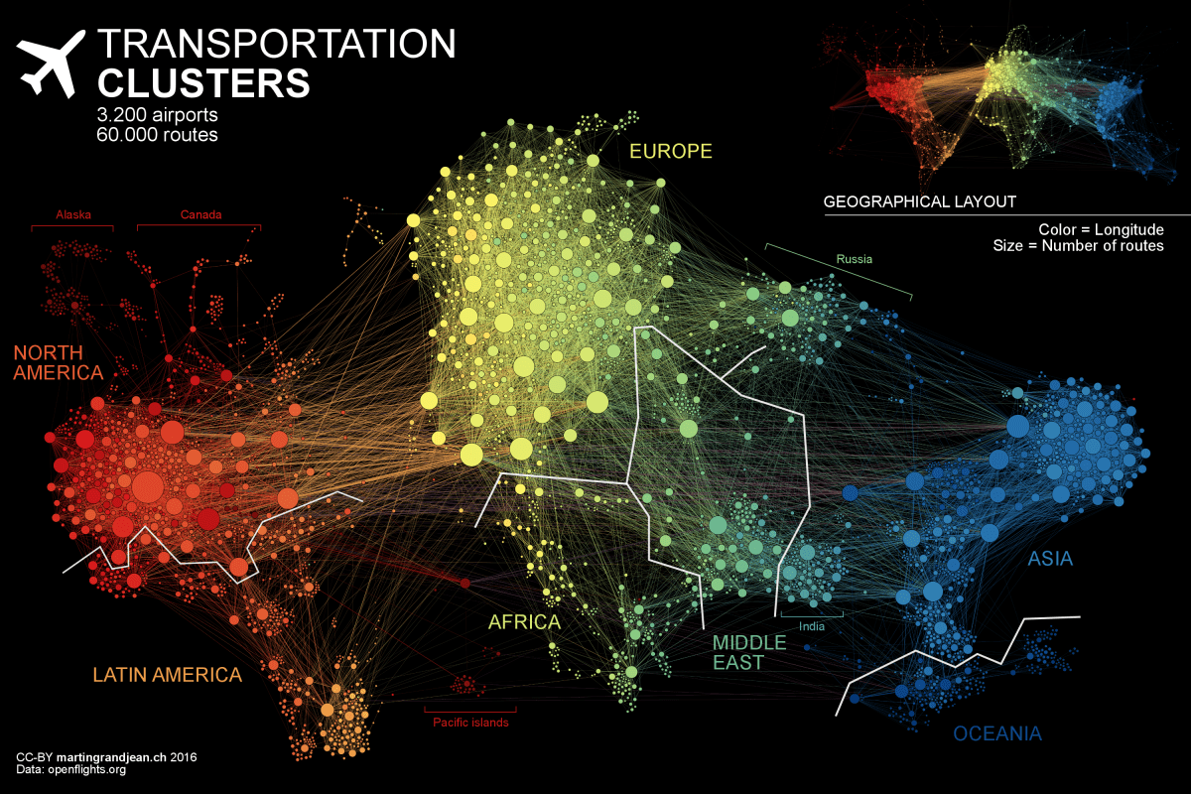
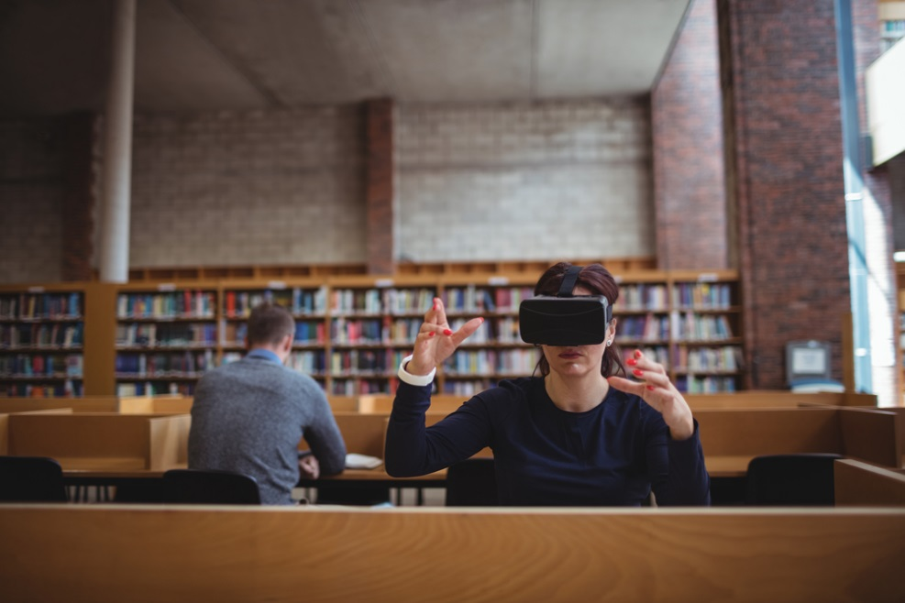
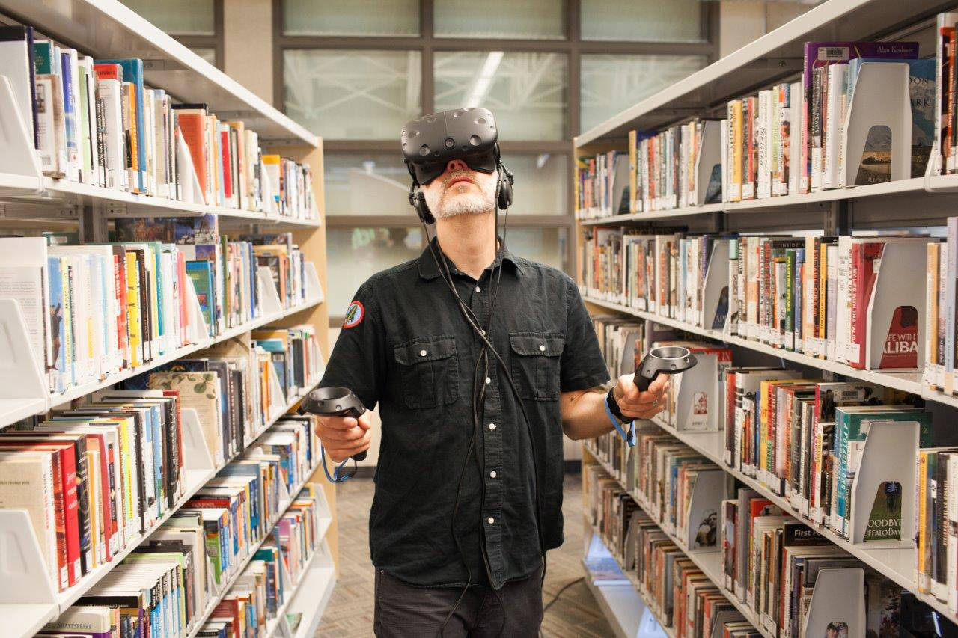
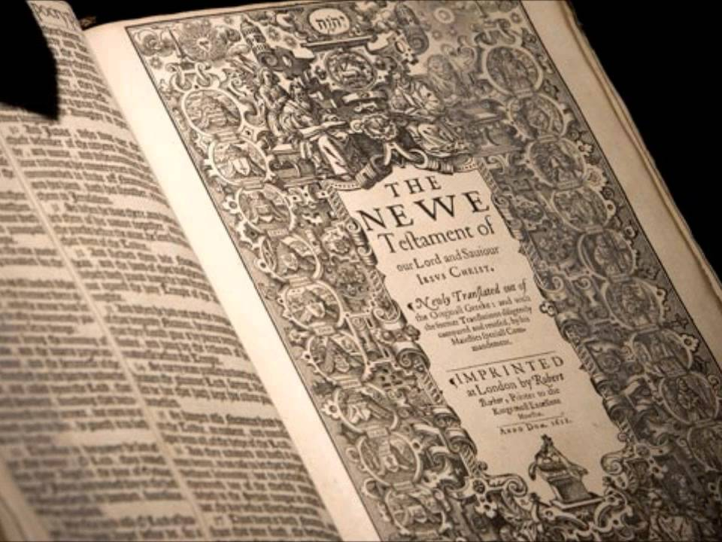


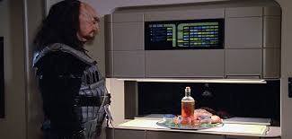

Slide 6
Canary
2
Problem
Students are so focused on studying that they forget to take care of their health.
How can we increase awareness of the consequences of crowding and bad air quality, and make students seek solutions?
It is happy when your brain is happy.
A virtual pet that raises awareness of air quality, and a trophy for those who help it survive the “blok”.
Own it, decorate it, love it.
If you don’t take care of your health it will die. :(

Slide 7
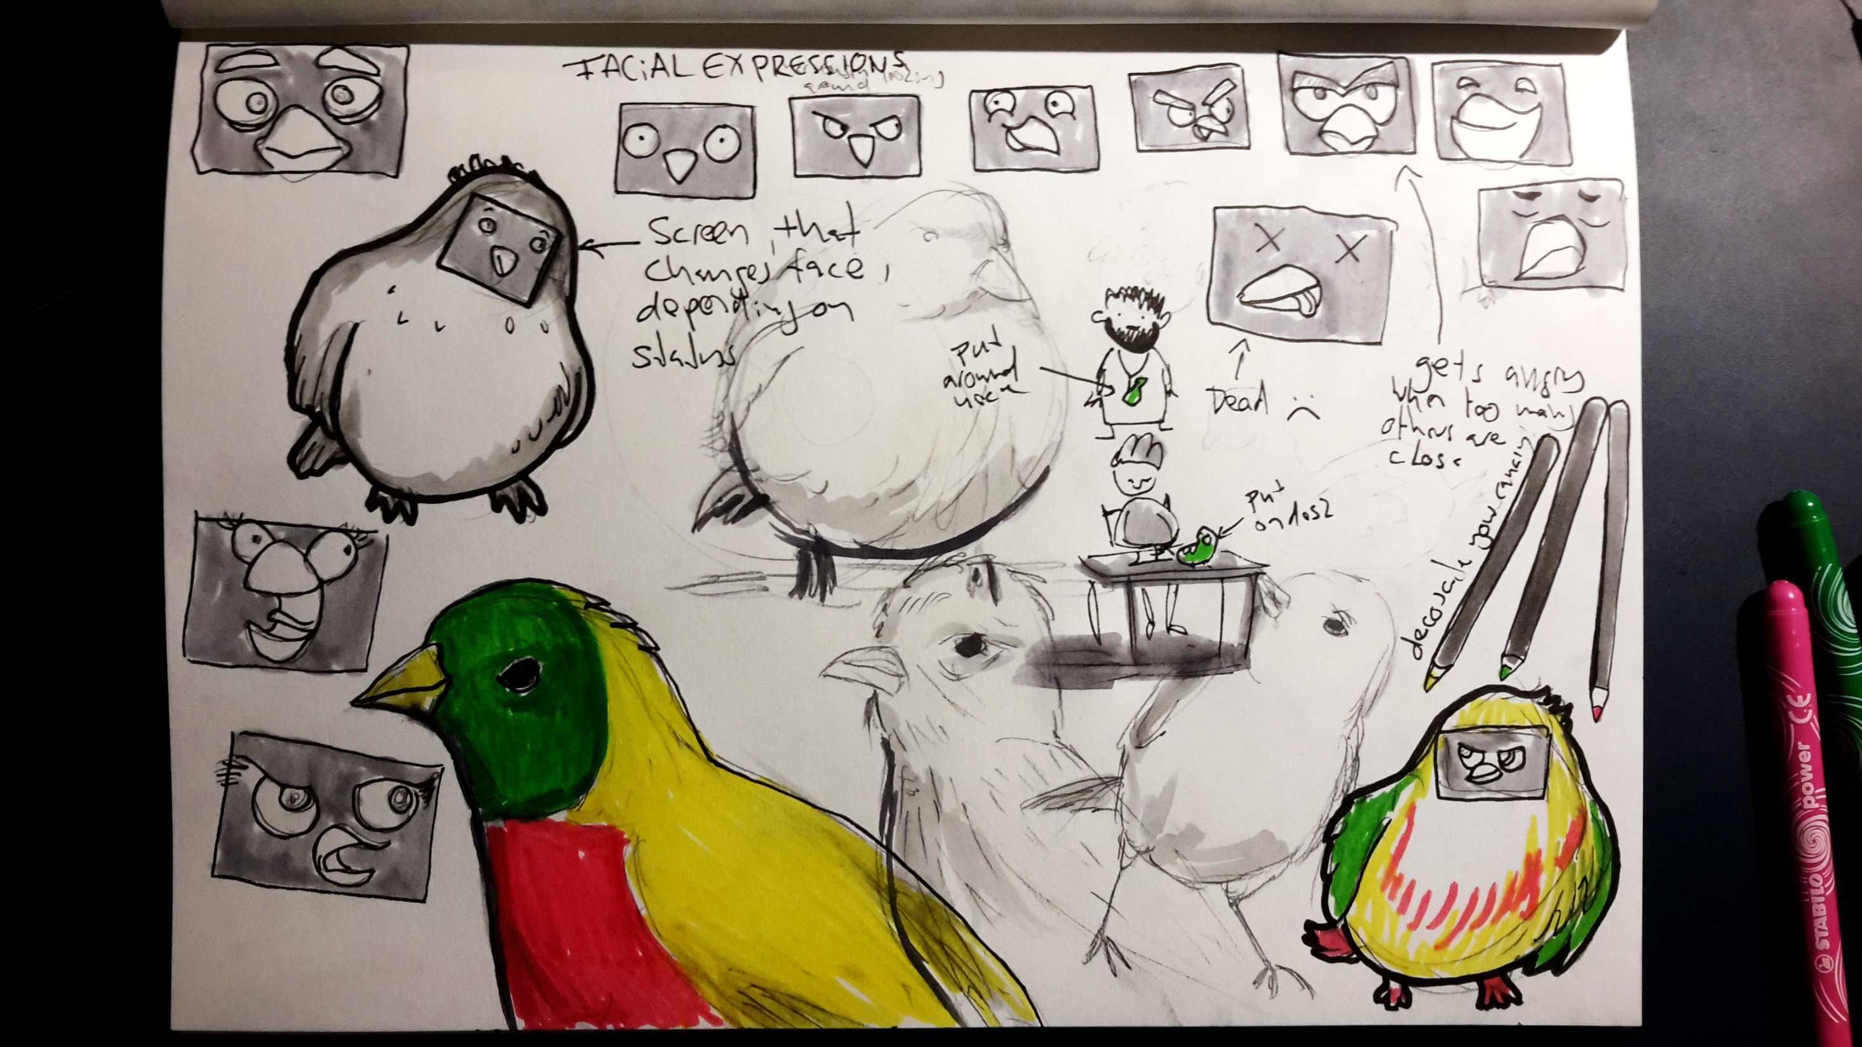

Slide 8
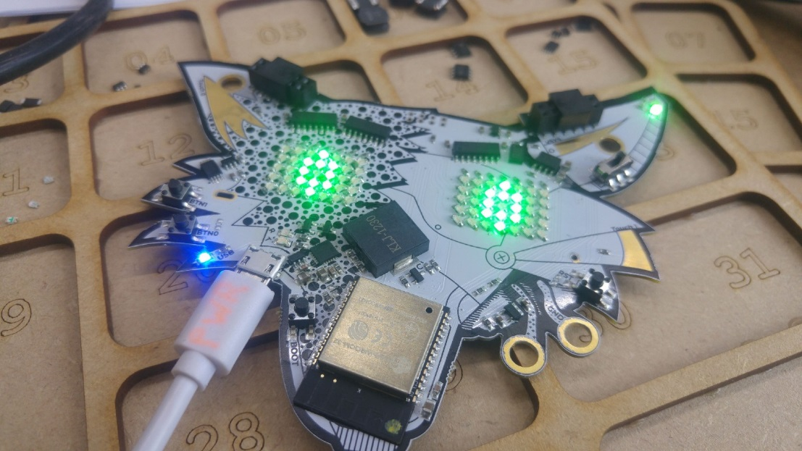
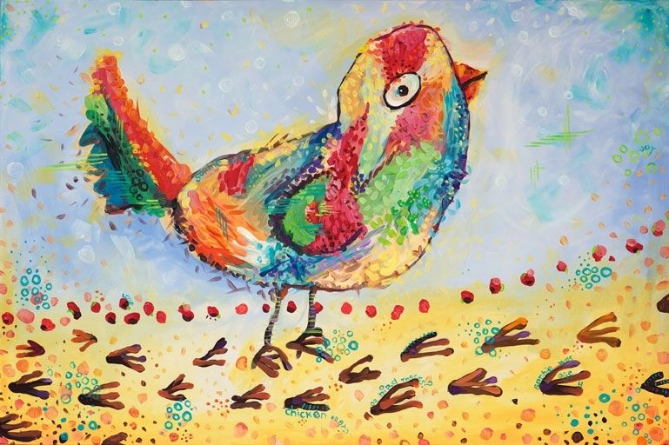
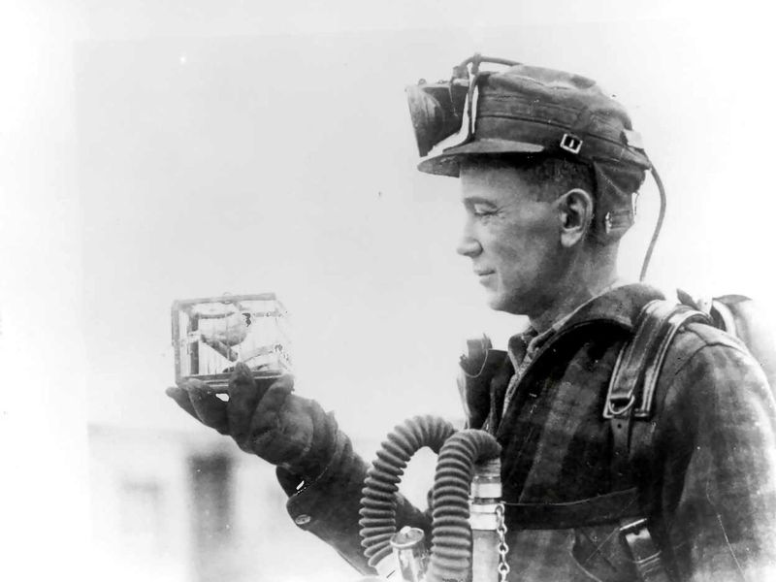
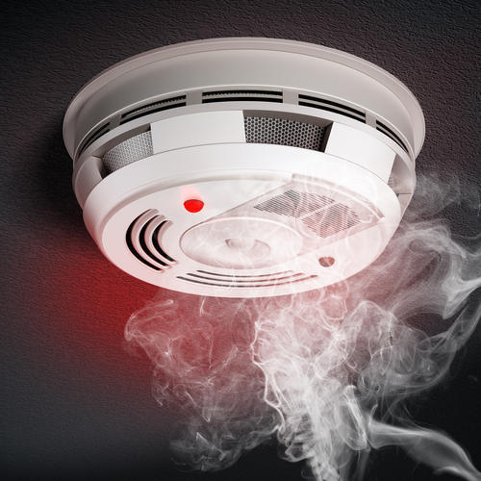

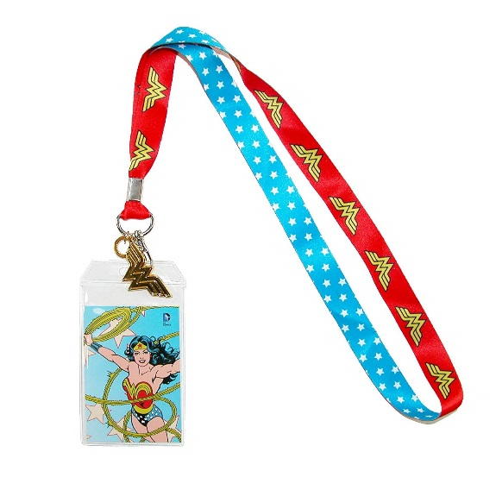

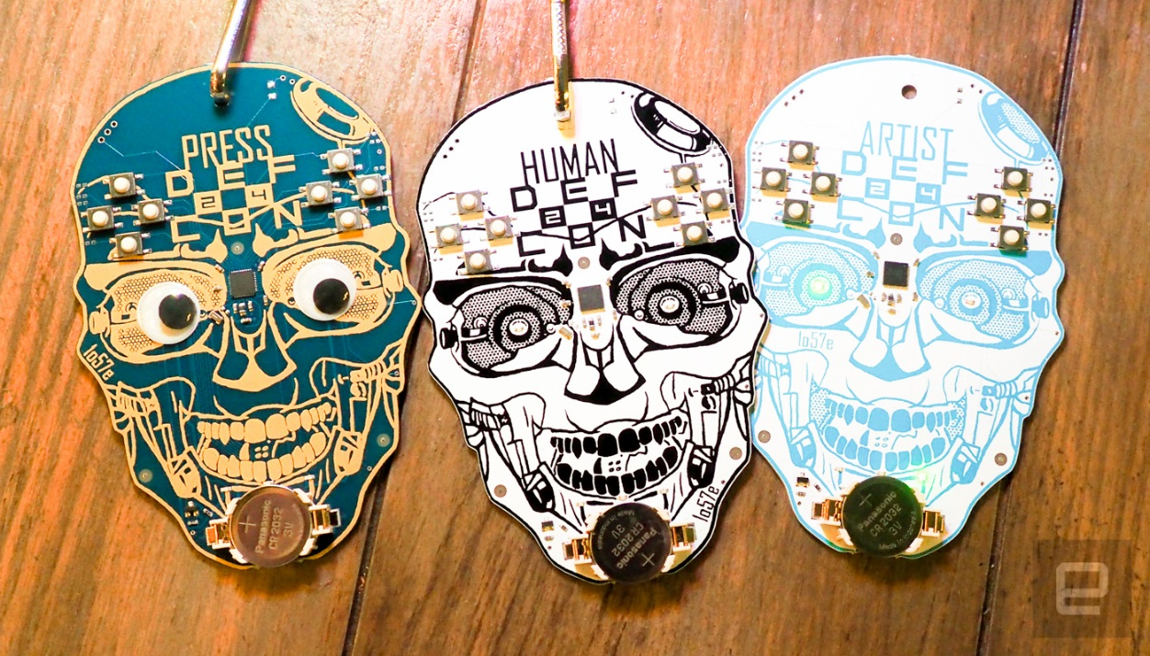
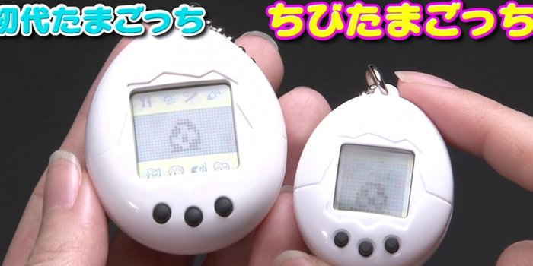
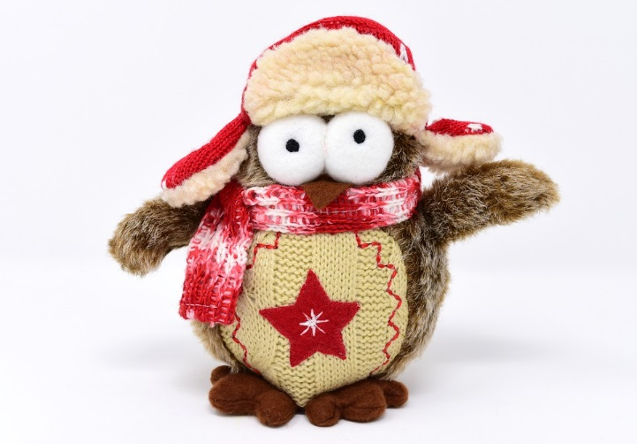
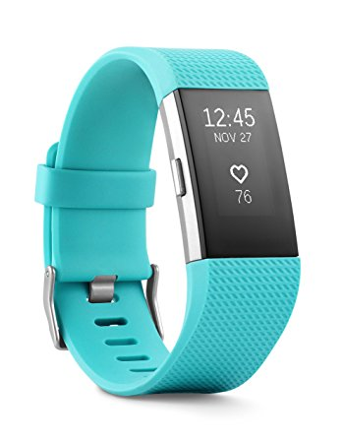

Slide 9
Shared Metabolism
3
Problem
Same as Canary, but more sinister.
An oxygen supply system that gives oxygen to those who need it most.
O₂ is distributed inversely proportional to cognitive performance.
Make people think: I can always breath the room air, of course, but which one is better? Should I be envious of other people’s air? Am I willing to breathe bad air so that someone else can study better?

Slide 10
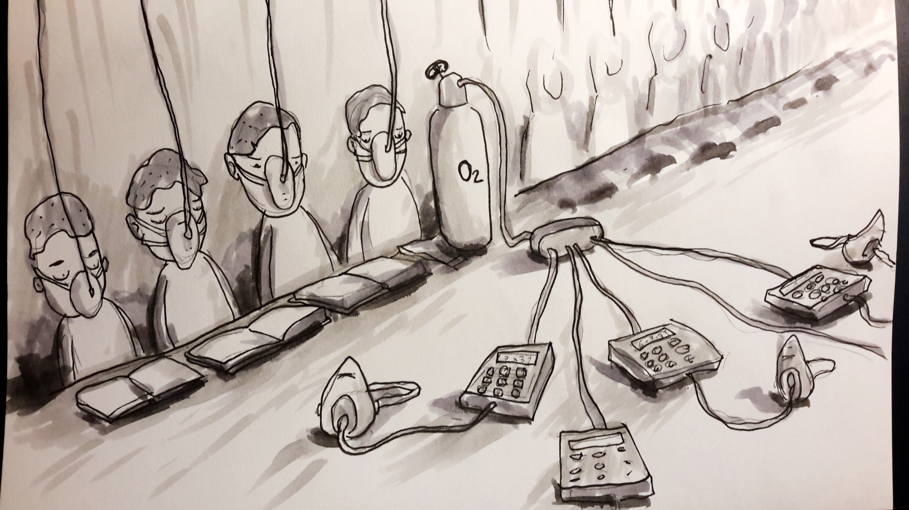

Slide 11
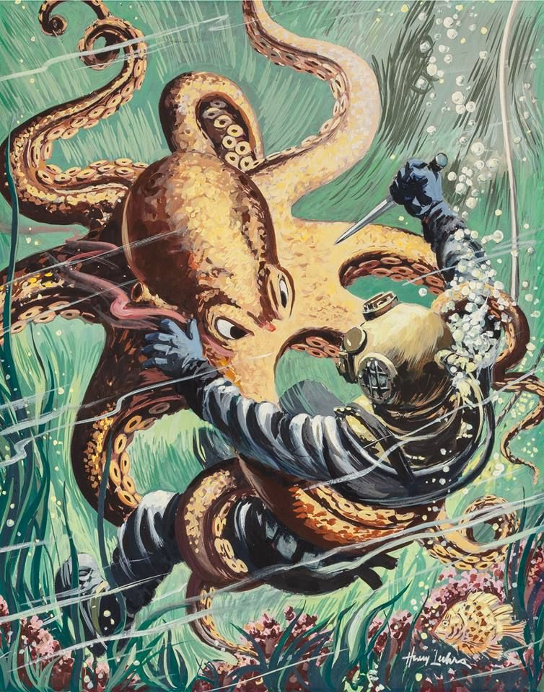
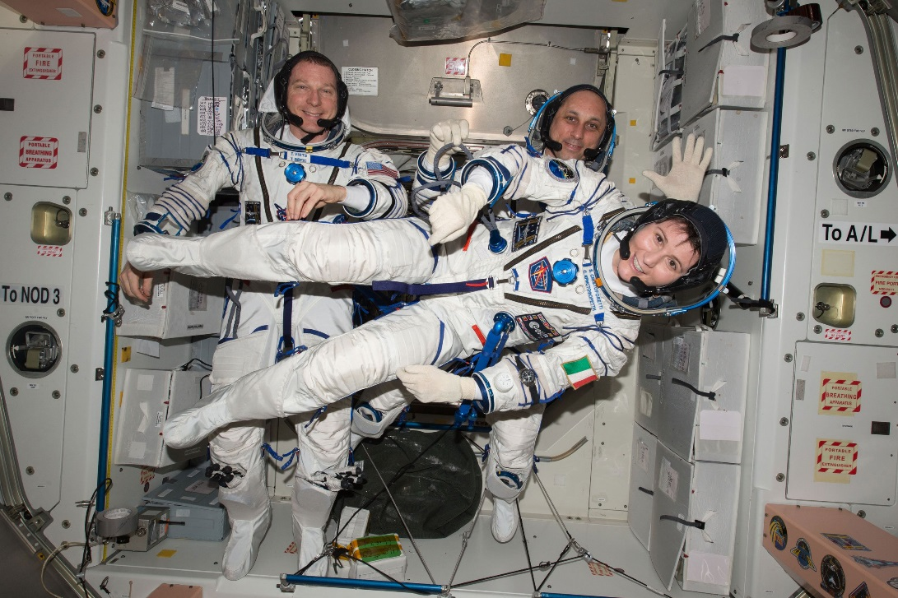
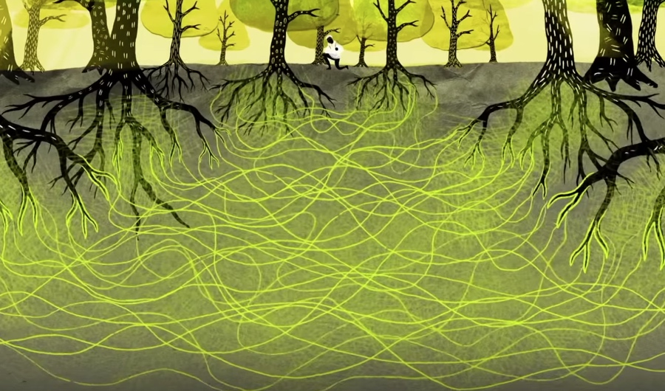
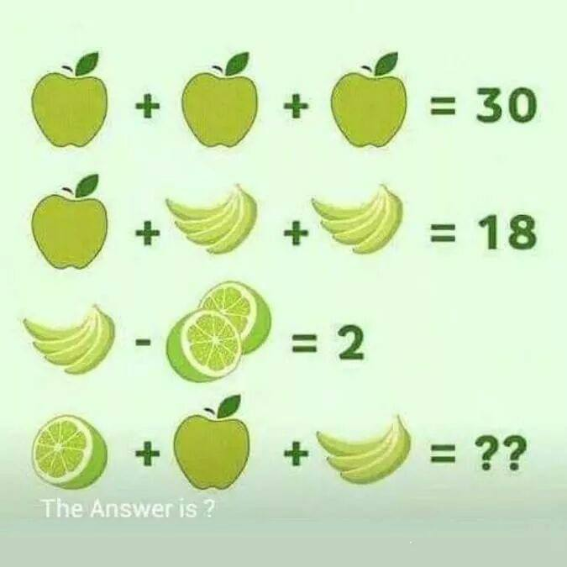

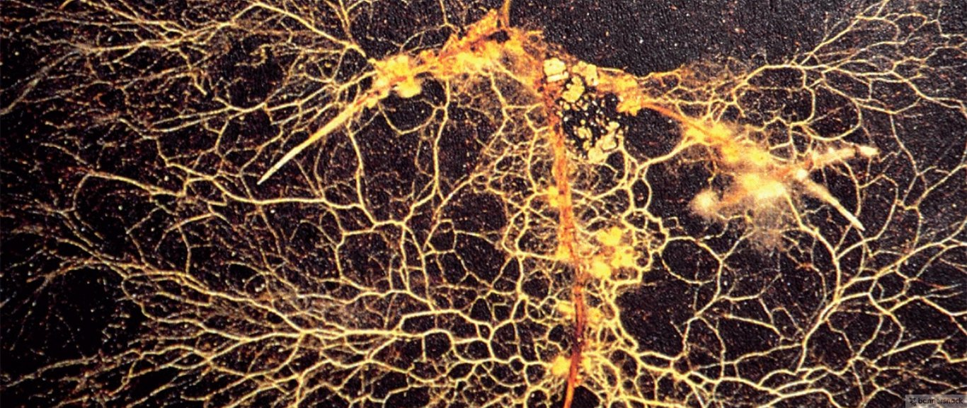
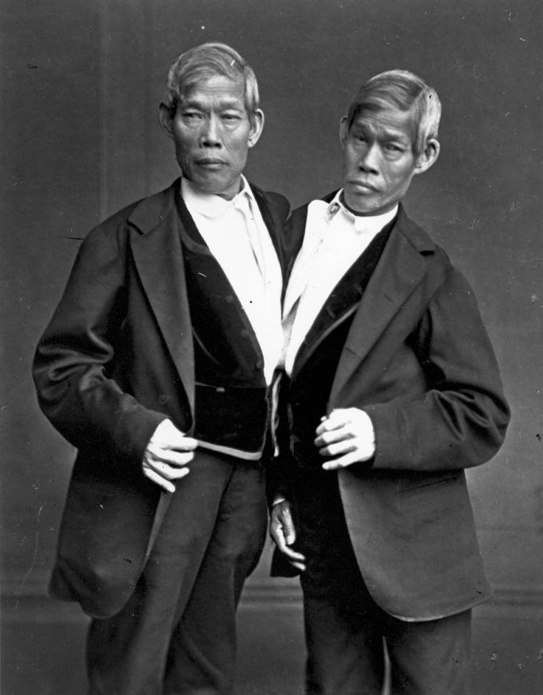
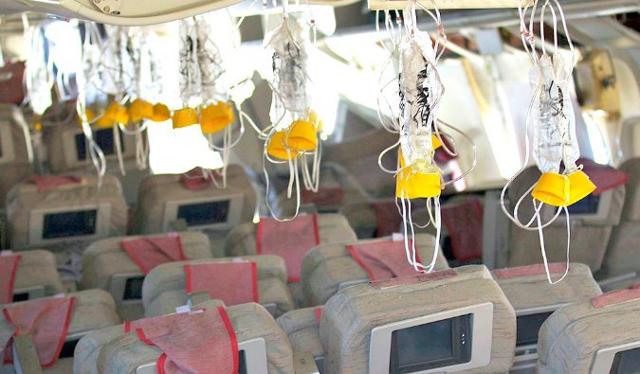
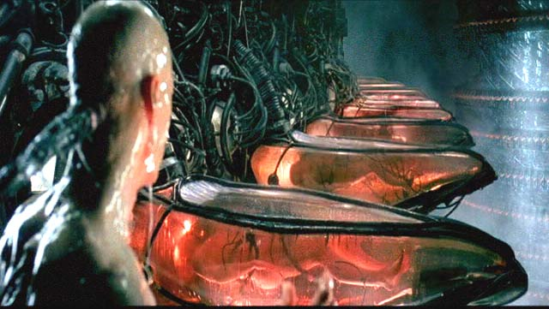
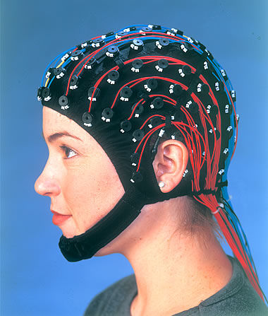
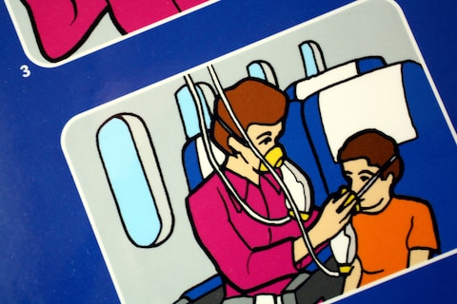
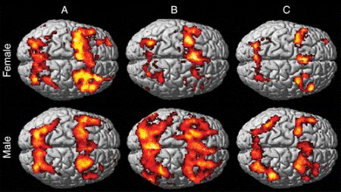
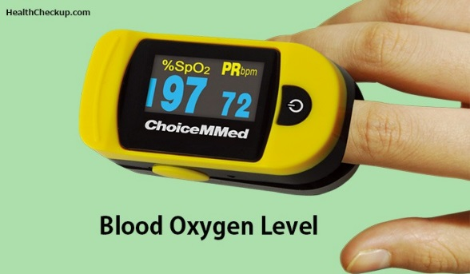

Slide 12
Peer-Pressure Helmet
4
Problem
Studying in a group makes you work harder.
How can we recreate this “peer pressure” outside of the library?
Headgear for the easily distracted.
Create and experience peer-pressure in the comfort of your own home (or wherever you are studying).
A decentralized panopticon where everyone is a prisoner and a guard.

Slide 13
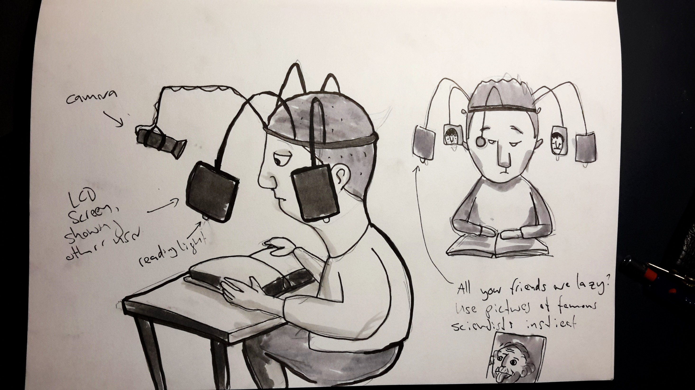

Slide 14
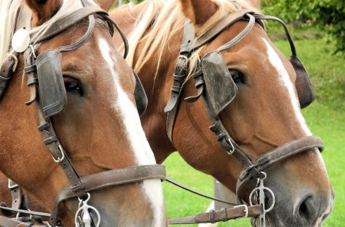
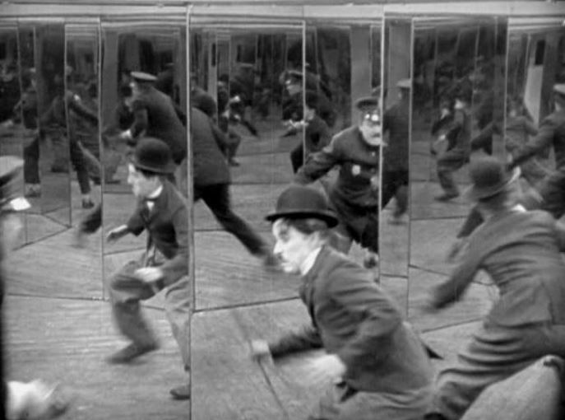

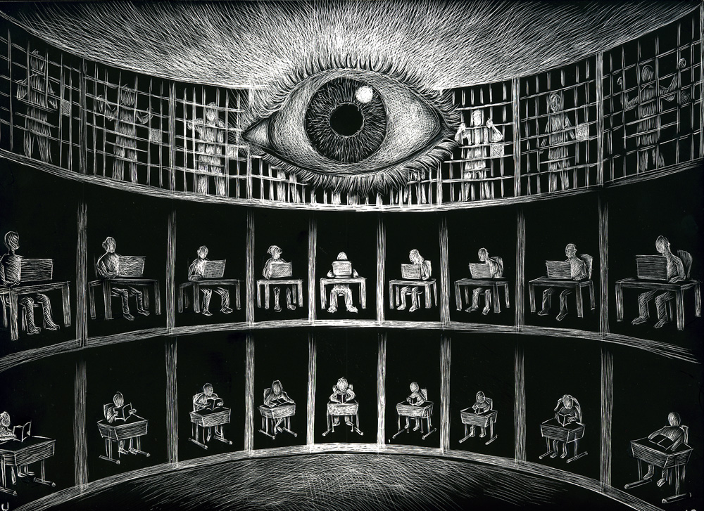
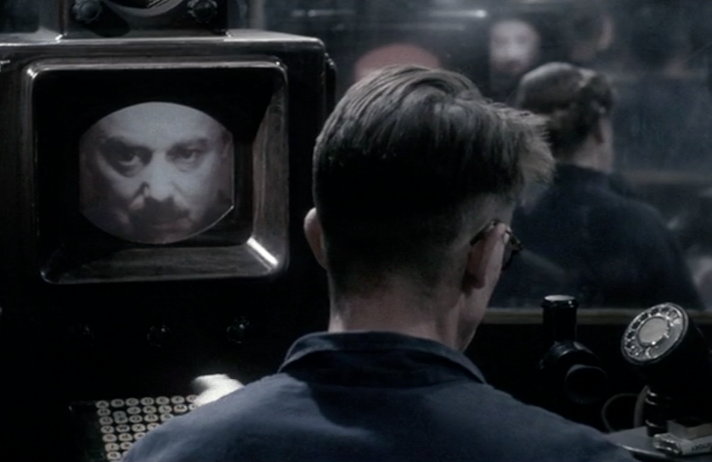
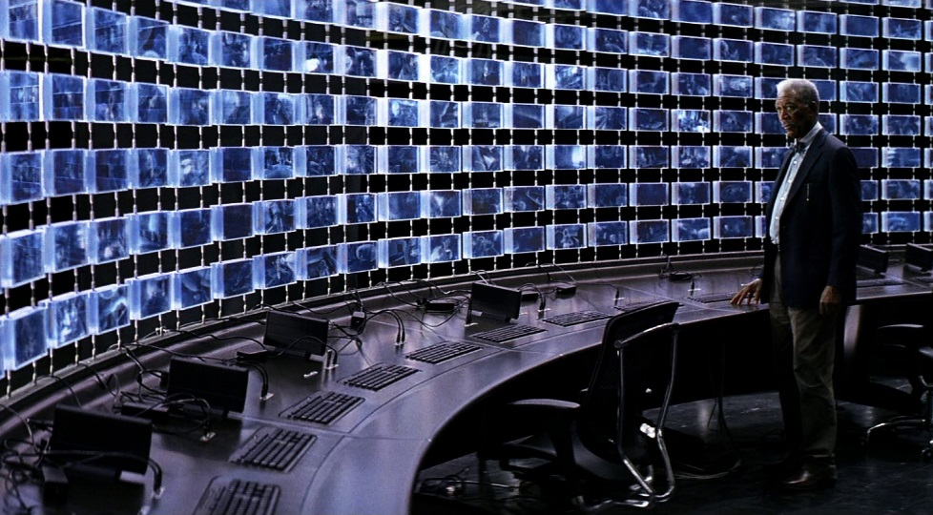
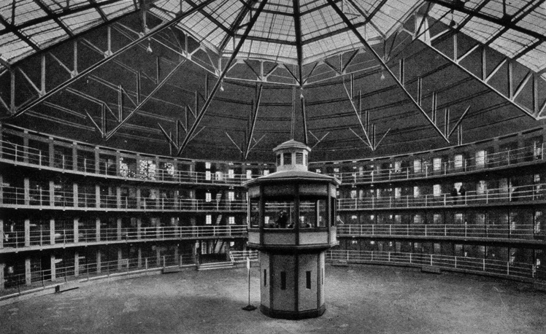

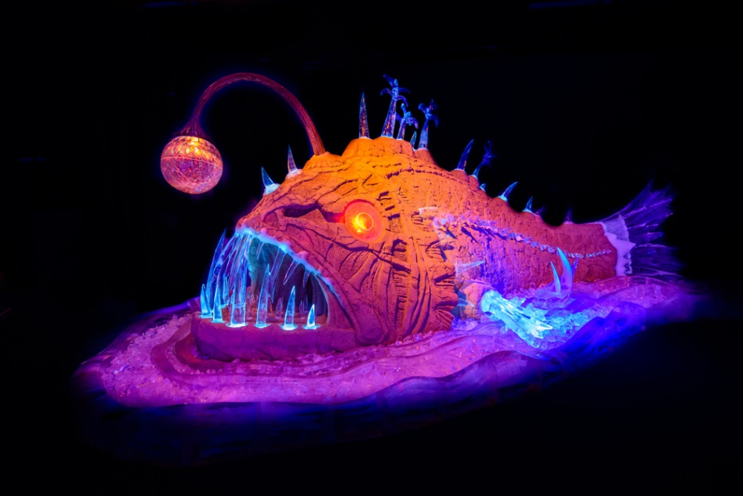
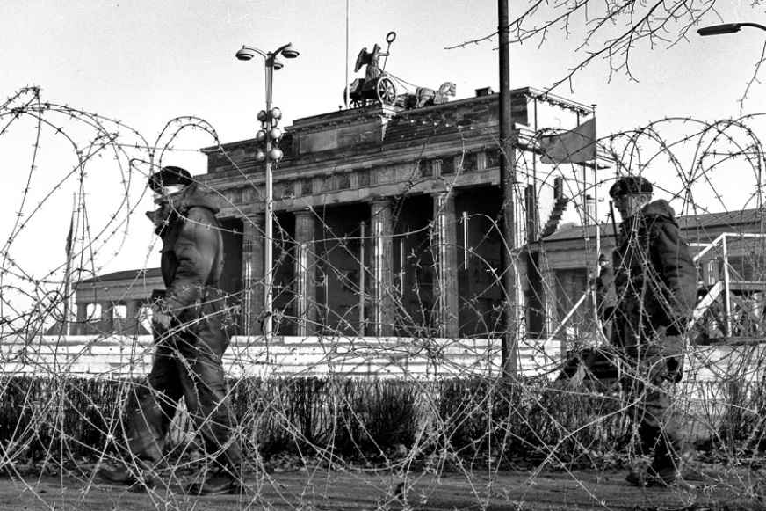
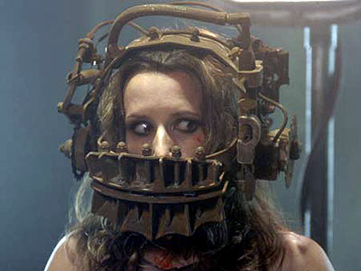
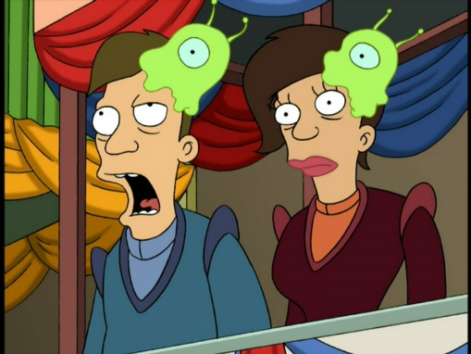

Slide 15

5
Problem
Same as Peer Pressure Helmet, but less sinister and more fun.
A chair that registers if someone is studying and pushes them to work harder.
Gamify the study experience. See how you compare to the best, next best, the bulk of the others.
The chair & table show who spent the most time there. Are you worth stepping into their footsteps? Are you taking away their favorite spot? Can you beat the highscore?

Slide 16
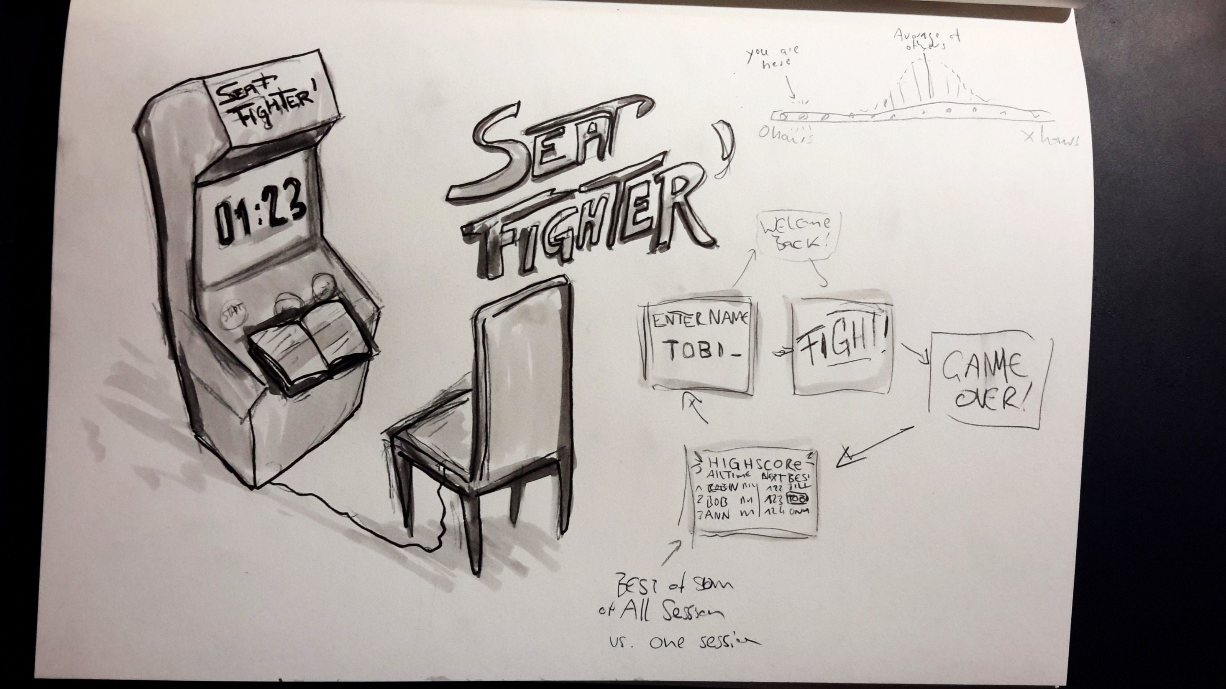

Slide 17
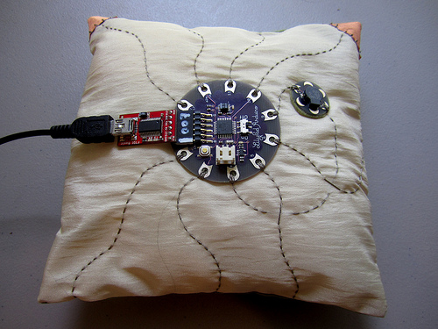
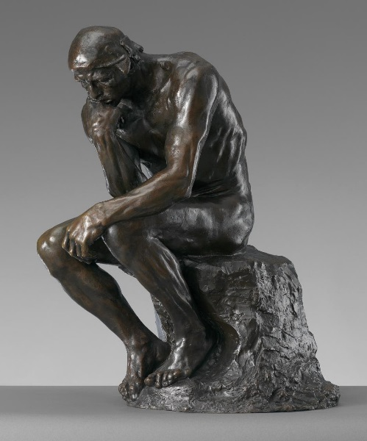
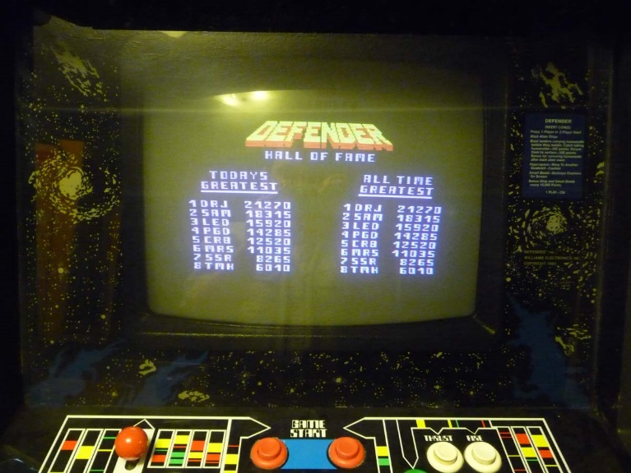

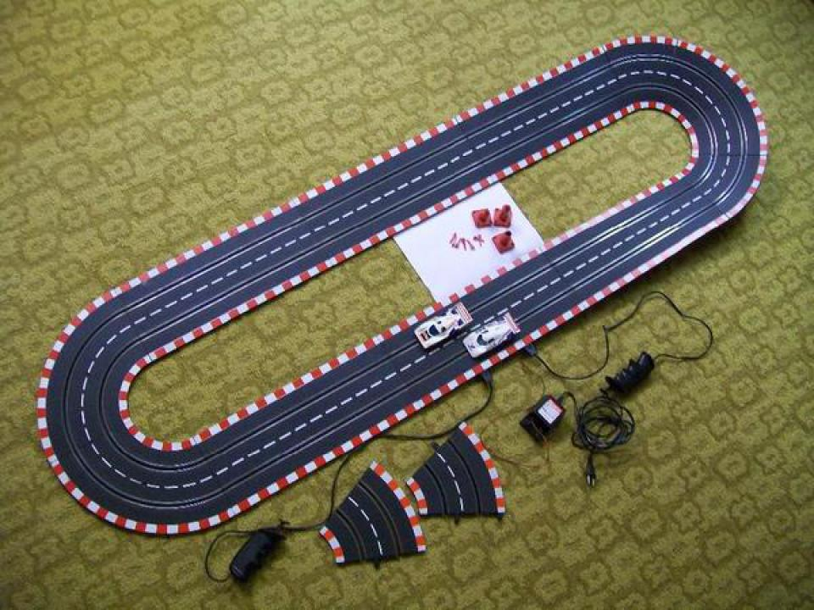
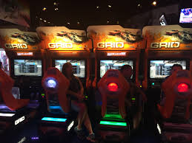
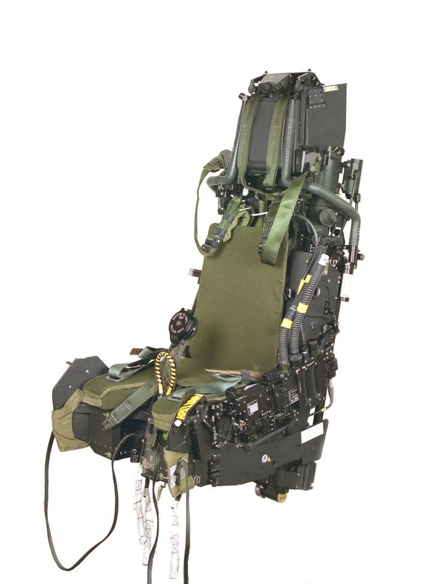








Slide 18
Carbon Copy Table
6
Problem
How can we transfer knowledge and experience between library users?
A library table that keeps traces of what you learn, and shows them to others.
“Information is the only thing you can give away and keep at the same time.”
Take notes or doodle on the table. Take a copy of your notes and doodles home.
Others can see the notes you made, rewind, remix, and copy them for themselves.

Slide 19











Slide 20
Whispered Words of Wisdom
7
Problem
Same as CC Table, but more ludic.
Time capsules for thoughts.
Leave your wisdom (or nonsense) for future generations to find.
Time-delayed one-directional information exchange with random people.
Intriguing artifacts, hidden in the library, that create a sense of mystery, surprise, and playfulness.

Slide 21


Slide 22




















Slide 23

Self-Observations
Overcoming creative inertia is hard.
Good ideas are the children of mediocre ideas.
Doing “breadth first” search is hard.
Maslow’s hammer is real, and it hurts.
I’m now in a polygamous marriage with all my ideas.

